Slide 1
Error Budget policies
OW

Slide 2
Overview
A system can be in three reliability states with respect to an SLO: happy, sad and uncertain.
The following illustration shows how one can use error budget monitoring to figure out which of the three reliability states the system falls into.
The team should have a set of policies defined for the states and follow the operational guidelines in them.

Slide 3
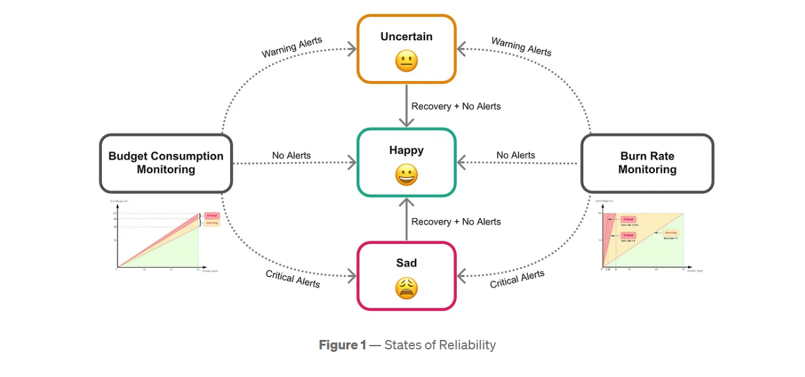
..

Slide 4
Happy State
Conditions:
No alerts fired, and error budget consumption is below 75%.
Policy:
At this stage, the system meets currently accepted reliability standards and we consider customers happy. New feature development is allowed. The team can take risks and do experimentations as there is enough budget left for potential failures. Furthermore, if budget consumption is consistently hovering below 10%, SLOs can be tuned with stricter targets.

Slide 5
Uncertain state
Conditions:
Warning alerts have been fired, but not critical alerts.
Policy:
At this stage, risky deployments should wait until investigation is complete because new errors can mask current issues. Tickets should be created and prioritized for investigations. Delayed investigations could push the system to “Sad state” and consume the entire budget.
If for any reason a team cannot adhere to this policy, they can temporarily reevaluate SLO thresholds while understanding the risks and implications. This should be communicated well to stakeholders and tickets should be created for future work to get the SLO threshold upgraded to the current value.
If the system recovers and operational state conditions are met, follow the “Happy state” policy.

Slide 6
Sad State
Conditions:
Critical alerts have been fired.
Policy:
(This is also known as “Out of Budget Policy”)
Site reliability engineering (SRE) team or the support engineering team should be paged, and an incident ticket created.
Application code should be frozen until the remaining error budget reaches at least 25% and all alerts are cleared up. Product feature releases will be completely halted.

Slide 7
..
The only exceptions that are allowed will be:
Fixes to address the root cause of SLO miss
Fixes that have the highest priority (e.g., changes that involve legal ramifications if deadlines are not met)
Security fixes
Finally, if a team finds that an SLO miss happened due to reasons out of its control, it can adjust the error budget

Slide 8
Outages caused by dependencies
If an outage was caused by a service maintained by another service provider team, the dependent team should create a ticket with the service provider team to investigate the issue. If the service provider team has SLOs and error budgets defined, the dependent team can forego out of budget policy as long as the service provider team has enacted their own error budget policies.
For an external dependency, the SLAs should be accounted for at the time SLOs were defined. If the 3rd party vendor’s outage broke the SLA, the team should engage with the vendor through proper channels to get compensated for the reliability miss. The team should create an investigation ticket internally to track progress.

Slide 9
..
If a certain dependency has been identified as the root cause for recurring SLO misses, then the team should consider removing that unreliable dependency from the system.
Although this is a definite solution to bring the error budget under control, it can take time. Therefore, the team should look for other measures to bring the error budget under control in the short term.

Slide 10
Policy Document
Teams should document policies for services they directly own. Shared services should be documented at the organizational level that is responsible for those services.
Policies should be shared among the stakeholders and incident response team.
Application run books should be updated with the link to the policy document for support engineers to have easy access. The policy document can be placed either in a source code repository or central documentation source belonging to the team.

Slide 11
How to test?Adoption
Setup:
Inspirational SLO targets and error budget limits are agreed upon
Policy document created
Run books updated
Necessary trainings are done (within the team)

Slide 12
..
Alpha Testing / 1st 30 Days:
Monitor
If entering “Sad state” then have all the ceremonies but don’t actually block releases
Beta testing / 2nd 30 days:
Adjust limits based on learnings
Apply “Sad state” rules
Optional: If necessary, team has the flexibility to adjust SLO targets and error budget limits with approval from stakeholders

Slide 13
Operationalize
Follow the error budget policy
Every 6 months SLOs and error budgets are reviewed
Optional: SLO targets and error budget limits are adjusted with approval from stakeholders

Slide 14
Reporting
Regularly reviewing error budget alerts (warnings vs critical) and the tickets created for SLO misses is recommended.
Creating reports and dashboards at team level and application level would help identify high priority fixes needed to reduce risks and prevent potential outages.
Creating reports and dashboards at organization level would provide a high-level overview for engineering leaders to build strategies for long term reliability of your platform.

Slide 15
Reviewing at forums
When the policies are adopted by teams, it is recommended to have a recurring review process of SLOs and error budgets.
A weekly or monthly forum with the participation of multiple product teams and their leadership is ideal (e.g, at Expedia Group™️, we have weekly operational excellence forums).
Defects identified by the investigations of SLO misses should be reviewed at correction-of-errors meetings or post-mortem meetings. While improving reliability is the main goal, sharing learnings across teams is a similarly important goal.

